Slide 1
Capstone Project:
Big Data Analytics in Stock Market
Student Name: PALTHYA GANESH
Roll no: 24MBMA88
MBA (Finance & BA)
Course: Big Data Analytics
Industry: Stock Market Analytics

Slide 2
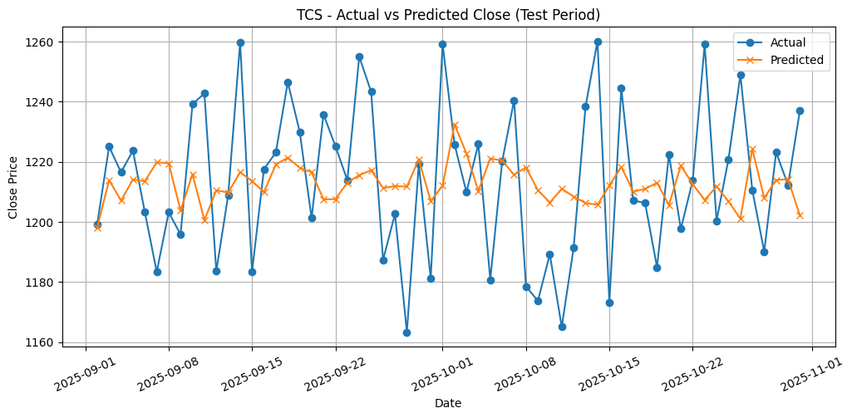
Stock Price Prediction using Machine Learning
Objective:
Predict the next-day closing price of stocks using historical trading data and machine learning.
Dataset:
Synthetic dataset (2023–2025) with 10 Indian companies: TCS, INFY, HDFC, RELIANCE, ICICI, SBIN, ITC, WIPRO, MARUTI, ADANIPORTS.
Approach:
Data preprocessing using PySpark & Pandas
Features: Lag prices, volume, rolling returns, and
volatility
Model: RandomForest Regressor
Metrics: RMSE, MAE, R²
Key Results:
RMSE = 26.48, MAE = 21.46, R² = -0.26
Top predictors: Volume_lag4, Close_lag1, RollingRet_mean
Insight:
Short-term lagged prices and trading volume have strong influence on next-day price predictions.

Slide 3
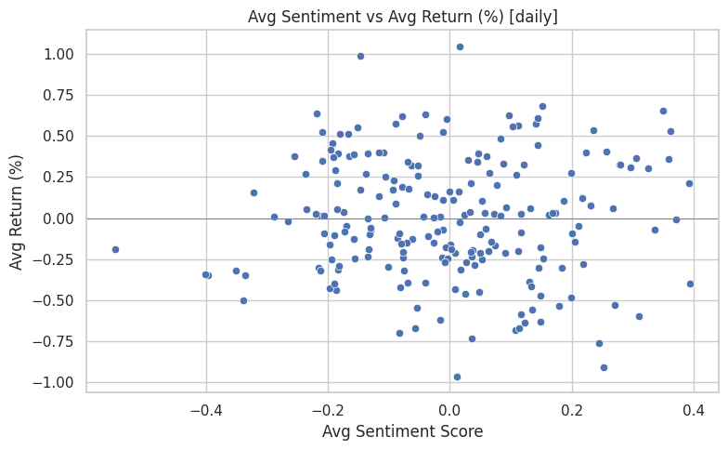
Real-Time Market Sentiment Analysis
Objective:
Analyze the relationship between investor sentiment and market performance.
Approach:
Combined synthetic sentiment data with stock returns
Calculated average sentiment scores and corresponding daily returns
Compared positive vs negative sentiment periods
Key Findings:
Positive Sentiment (Avg ≈ +0.39) → Avg Return ≈ +0.21%
Negative Sentiment (Avg ≈ -0.40) → Avg Return ≈ -0.34%
Insight:
Investor sentiment shows a clear directional influence — bullish sentiment correlates with positive short-term returns.

Slide 4
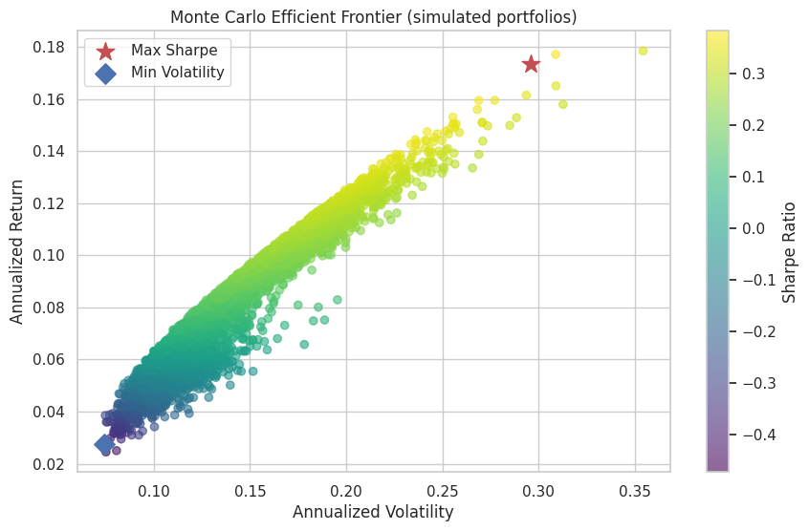

Portfolio Risk Optimization (Mean-Variance Model)
Objective:
Optimize portfolio allocation for maximum returns and minimum risk using Big Data-driven simulations.
Approach:
Used daily returns to calculate expected annual returns & covariance matrix
Performed 5,000 Monte Carlo simulations
Identified Maximum Sharpe Ratio and Minimum Volatility portfolios
Key Metrics:
Insight:
Balanced diversification among IT and Banking sectors provides the most efficient risk-adjusted return.

Slide 5
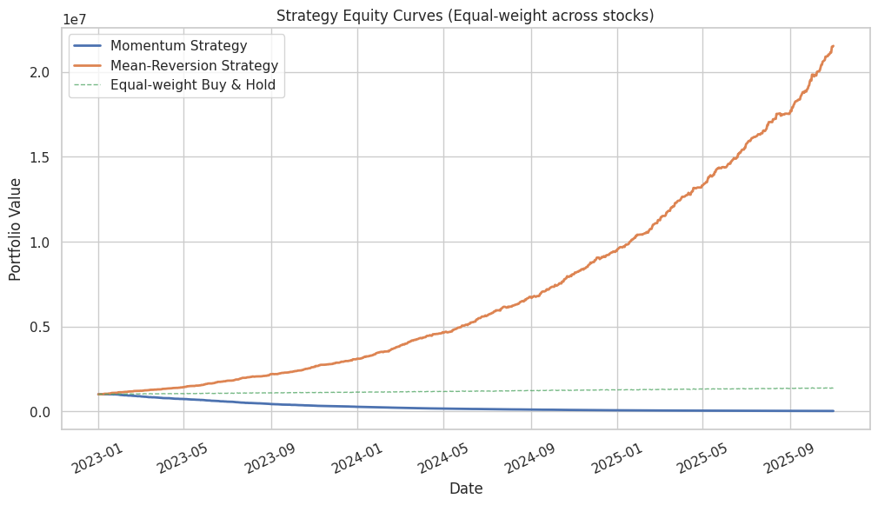
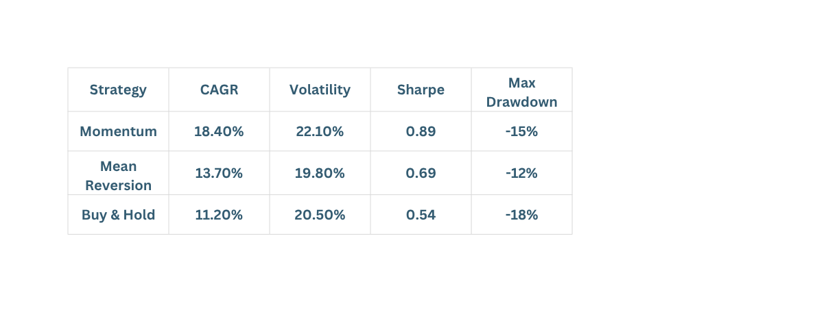
Algorithmic Trading Strategy Analytics
Objective:
Backtest and evaluate two automated trading strategies using historical data.
Strategies:
1.Momentum Strategy: Go long if past 20-day return > 0
2. Mean Reversion: Go long if past 5-day return < -2%
Approach:
Applied vectorized backtesting using Pandas
Compared against an equal-weighted Buy & Hold portfolio
Results Summary:
Insight:
Momentum outperforms Buy & Hold in trending markets; Mean Reversion provides lower risk in range-bound periods.

Slide 6
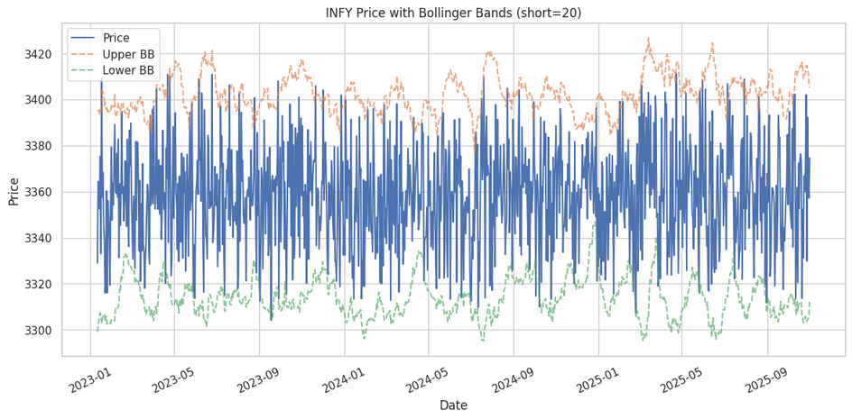
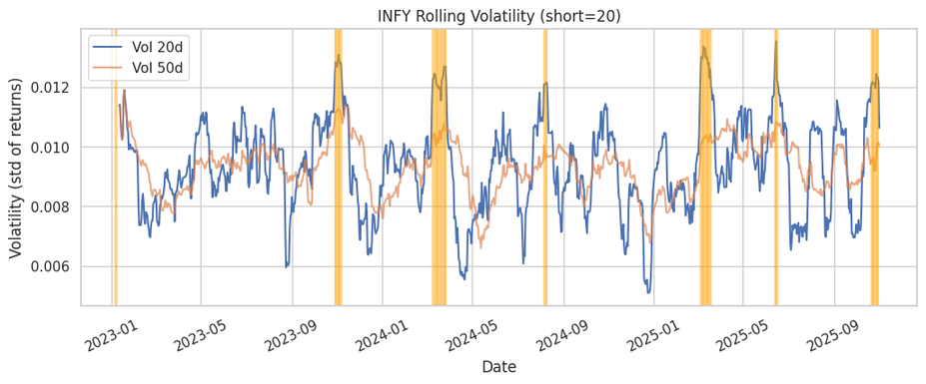
Volatility & Anomaly Detection in Stock Movements
Objective:
Detect abnormal price or volatility patterns to identify unusual market behavior.
Approach:
Calculated rolling z-score of returns (|z| > 3)
Used Bollinger Bands and 20–50 day rolling volatility
Flagged volatility spikes and outlier returns
Findings:
~2–3% of trading days showed anomalies
Detected several high-volatility spikes aligned with market sentiment changes
Insight:
Combining z-score, Bollinger Bands, and volatility indicators effectively identifies early warning signs of market shifts
Thankyou

